Slide 1


Electricity Demand and Price Forecasting
Project aims to develop an accurate and reliable forecasting model for electricity demand and prices, using a time series approach. The goal is to leverage weather data to enhance existing forecasting methods.
by Sriram Varma

Slide 2
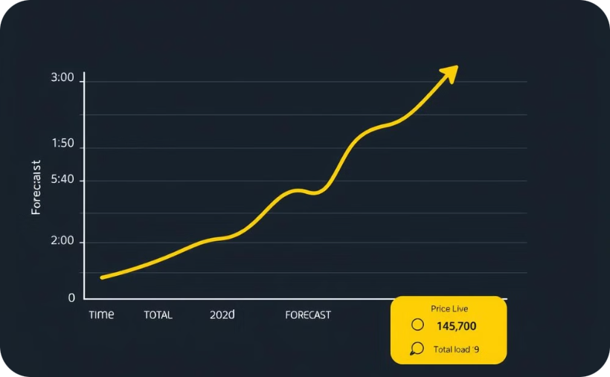
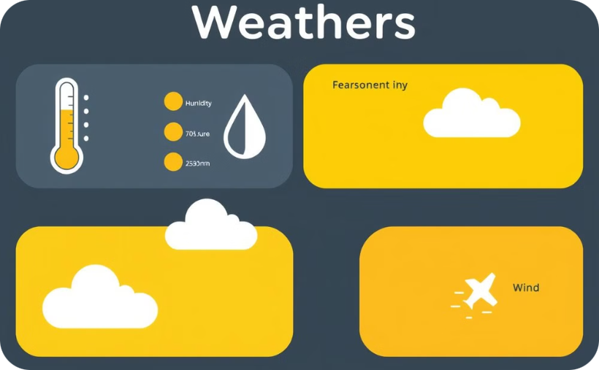
Dataset Overview
Energy Dataset
Weather Dataset
Load forecast, total load, price.
Temperature, humidity, pressure, and wind speed.

Slide 3
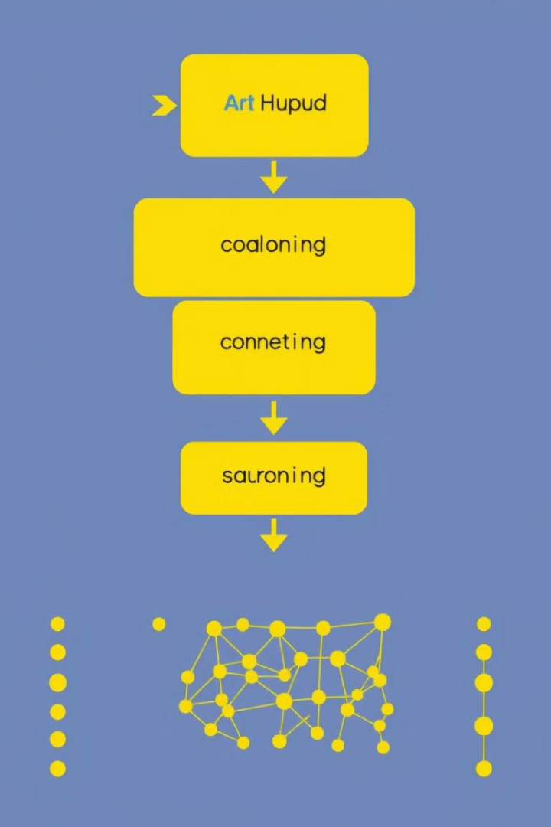
Deep Learning Model
1
CNN Architecture
2
Data Preprocessing
Utilizes convolutional layers for feature extraction from time series data.
Data normalization and feature engineering for optimal model performance.
3
Training and Evaluation
Model trained on historical data, evaluated using metrics like accuracy and mean squared error.

Slide 4

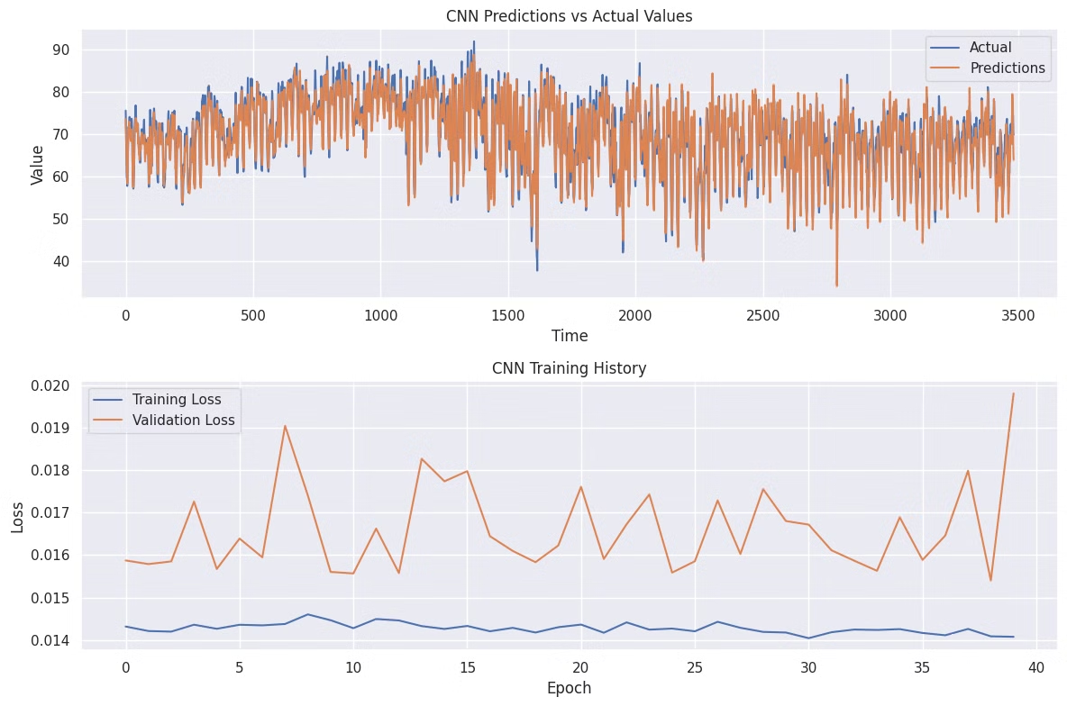
Model Outputs and Insights
1
Hourly Predictions
Accurate forecasts for energy demand and electricity prices.
2
Key Insights
Analysis of factors influencing energy consumption and pricing.
3
Performance Evaluation
Using metrics like Mean Squared Error (MSE), learning rate, epochs, batch size.

